Slide 1


Slide 2

Gym Management System
FLIP FIT
Group C

Slide 3
Framework for 5 days
1 week plan
Daily discussions covering various topics, technologies, and doubt resolution
Interactive discussion and collaborative brainstorming sessions with SME/Trainer to facilitate project progress and drive transformation, based on UMLs and technologies

Slide 4
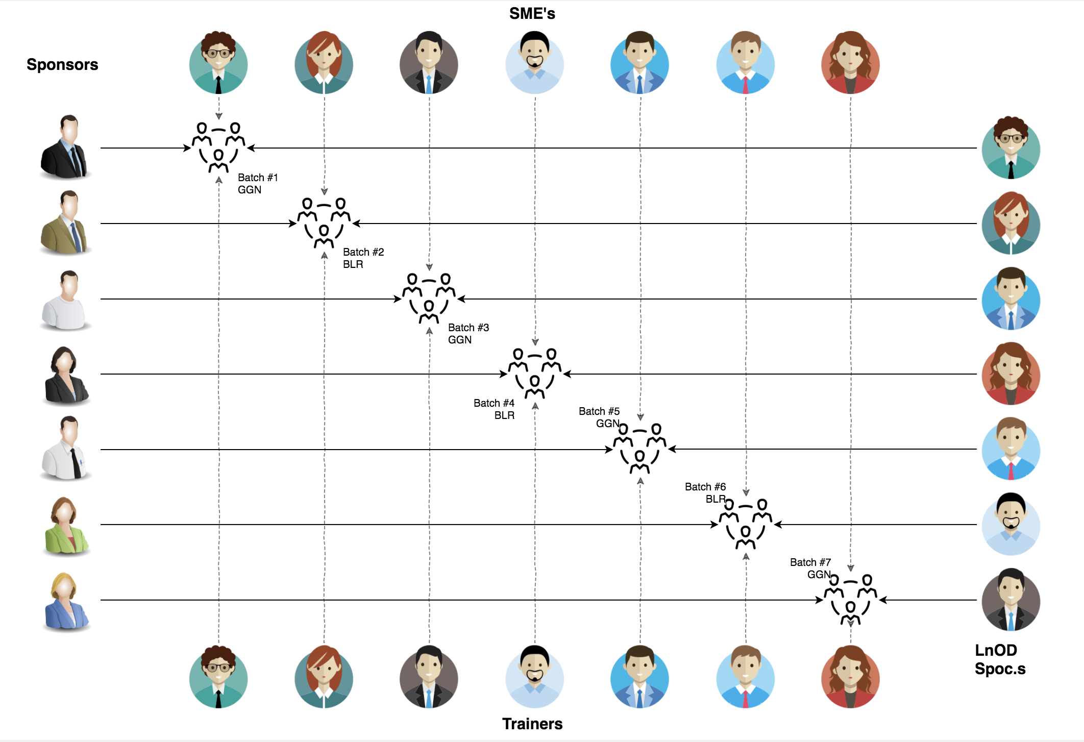
Skateholders
Sponsors
Flipkart
SME
Amit Balyan
Trainers
Sharatha Ramesh
Heena Bansal
Priyanka
Ram

Slide 5

Our next start NOW

Slide 6
5 DAYS OF TRAINING + PROJECT DEMO
5 DAYS
40 HOURS
2400 MINUTES
144000 seconds
LIMITLESS KNOWLEDGE

Slide 7

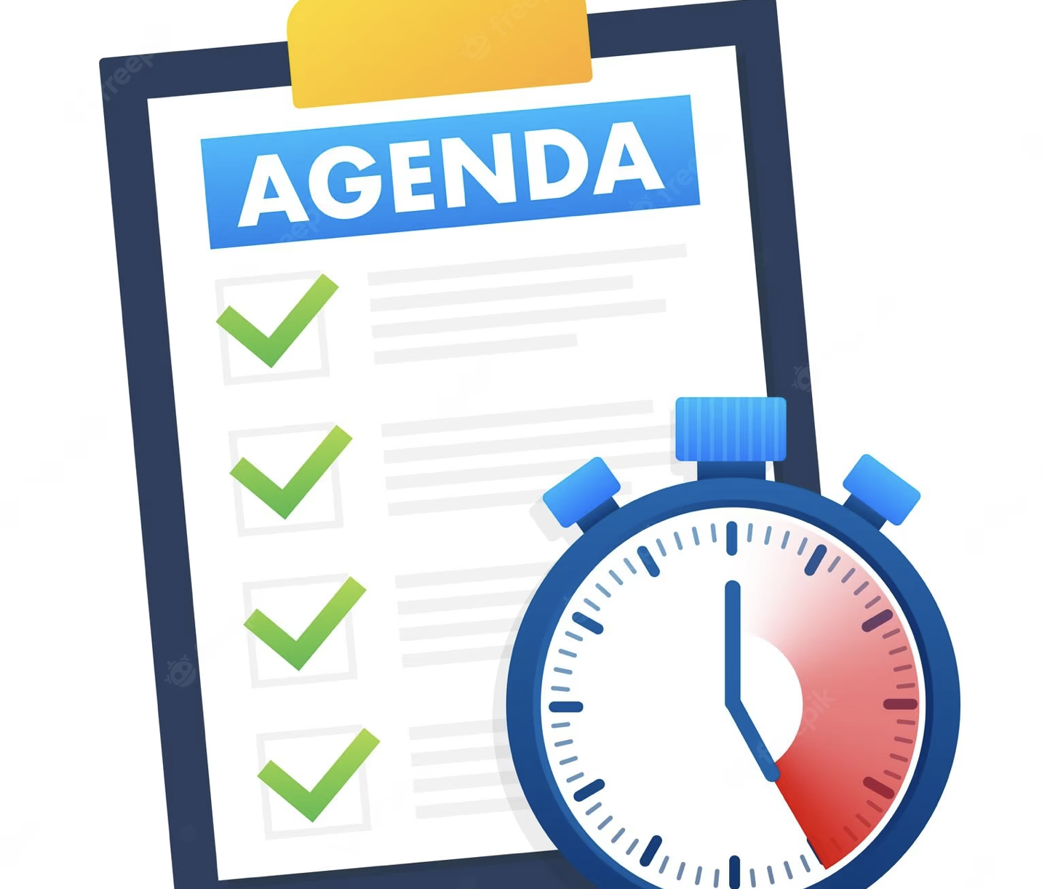
Our Journey
Our Team
Team Structure
Project Goals
Engineering Practices
Tech Stack
Development
Challenges & Learning
Demo
Questions

Slide 8

Our Journey

Slide 9
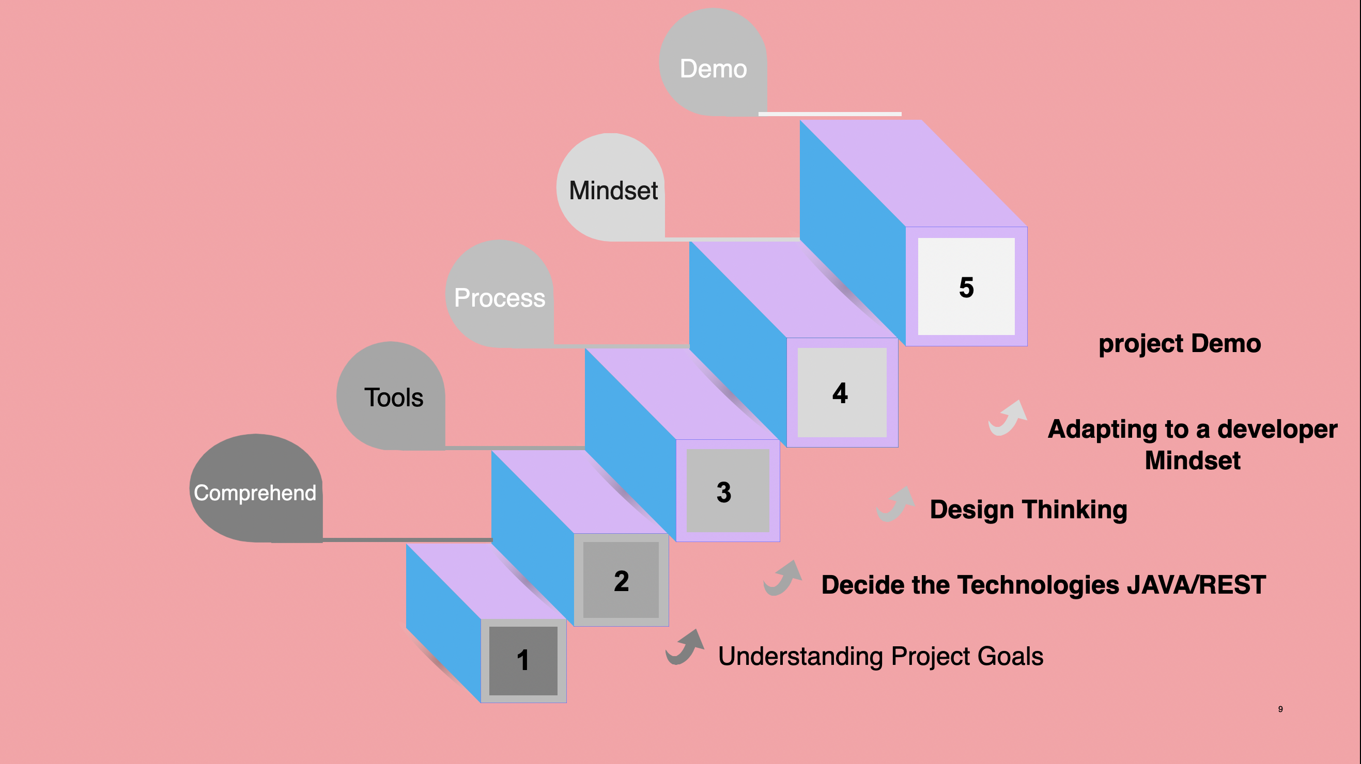

Slide 10

Our Team

Slide 11


Moushmi Rani
Rahul S
Group Leader
Amit Balyan
SME/Mentor
Ayush Verma
Naman Singh

Slide 12

Project Goal

Slide 13
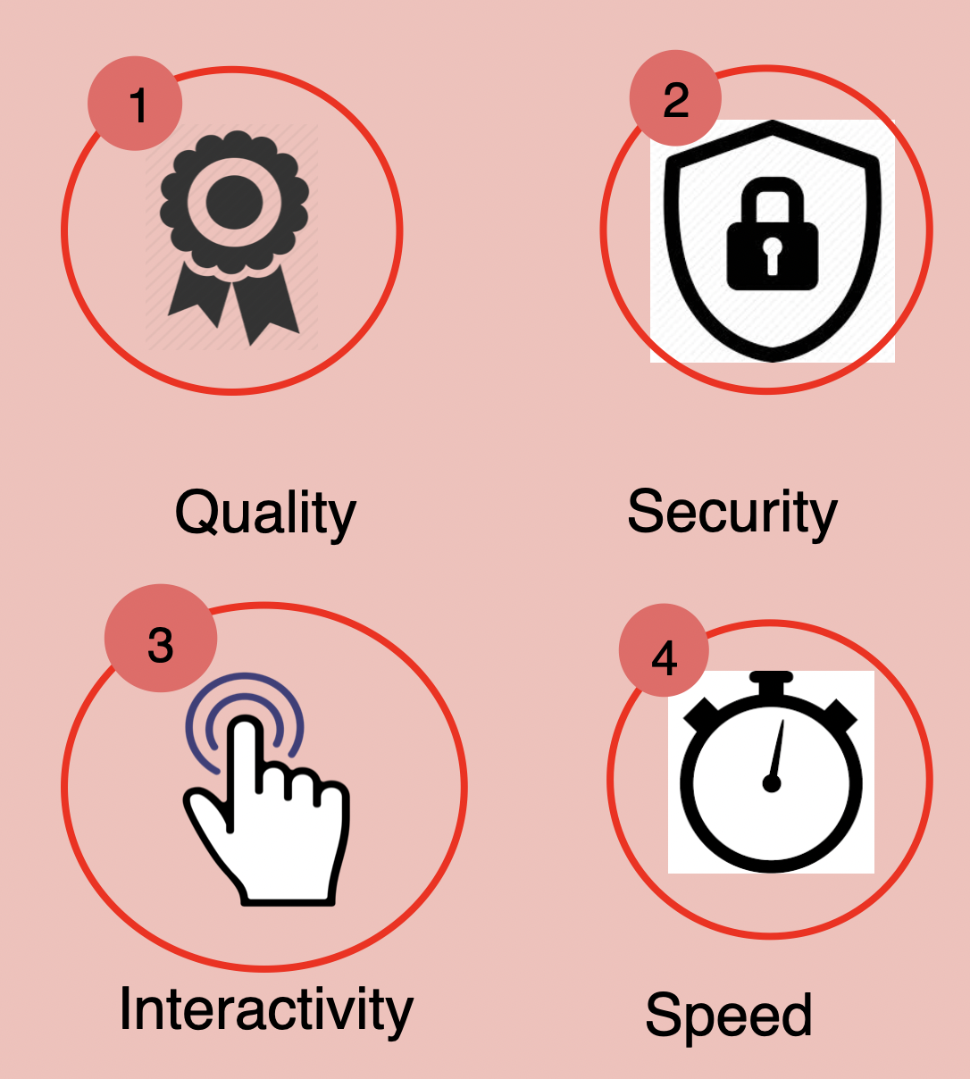
Our Vision
To design a Gym Management System using full stack development and technologies, where the gym owner can enlist their gym centres and customer can view the gyms and book slots.

Slide 14

Engineering Practices

Slide 15
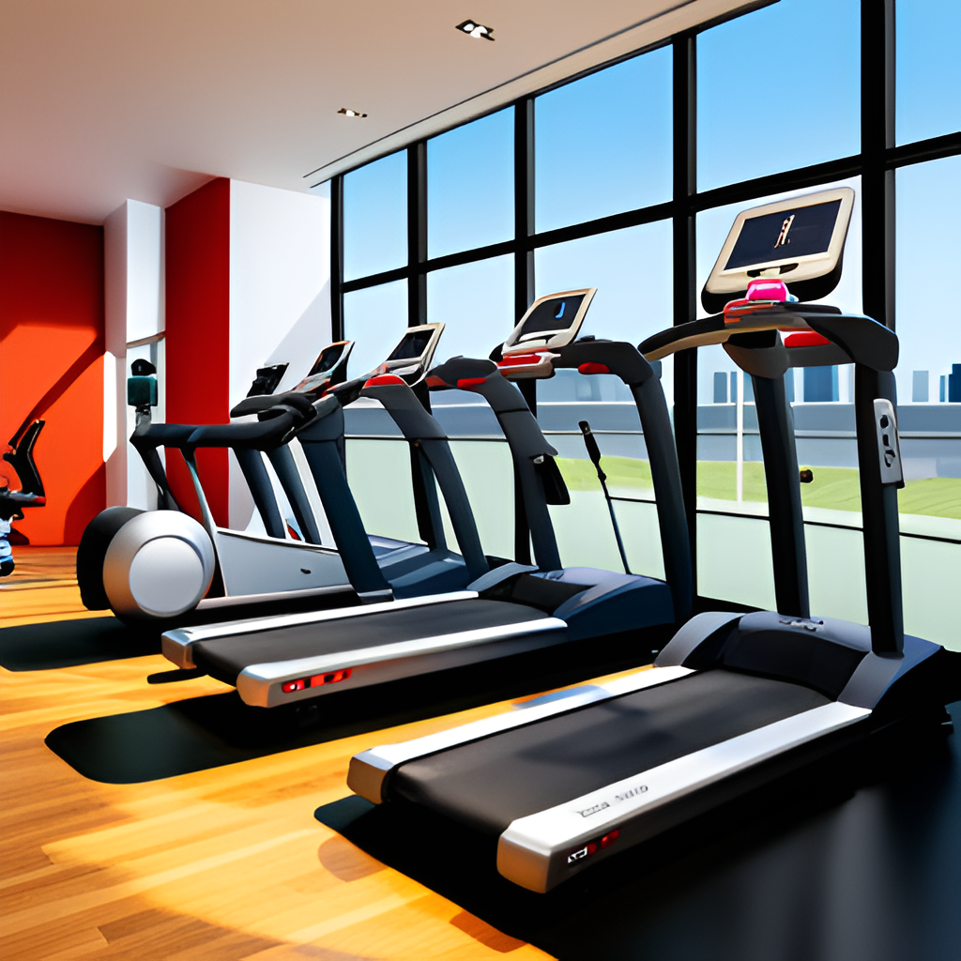
Problem Statement
Design a UI and a backend system for a new enterprise application that Flipkart is launching, FlipFit. Flipkart is partnering up with gyms across Bangalore to enter into the fitness space. For the Beta launch the requirements are as follows:
There are multiple centers in Bangalore.
Each center has n slots of an hour each. For eg the Bellandur center has only 6 slots - 3 in the morning of an hour each from 6 am to 9 am and similarly 3 in the evening from 6 pm to 9 pm.
The number of seats at each time-slot for a given center is fixed.
For simplicity’s sake you can assume that the slot info will be entered by the Admin only once.
User can perform the following operations:
Register onto the platform
View the gym's availability/unavailability for a particular day and slot at a center
Book a workout for a user if seats are available in that time slot at that center
User stories:
View all centers will details for a given city
Successfully book a slot by a user in a center in a particular slot
If user books another gym in the same slot, the old booking should be removed
If a user books a slot which is already booked by another user, an error should be shown
Ensure that there is no scenario where we are over booking.

Slide 16
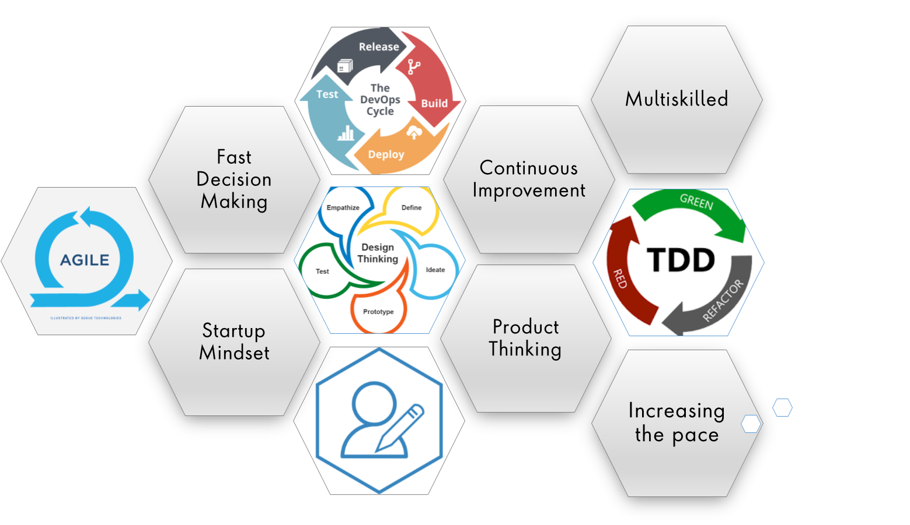

Slide 17

Tech Stack

Slide 18






Backend
Data
Tools
Core Language
SQL Database
SCM
Framework
BUILD TOOL
Testing

Slide 19

Development

Slide 20
Requirement gathering
Group formation
Requirement understanding
Research and analysis
Estimation
Sprint Planning
Sprint Grooming
Sprint Implementation
Delivery
LLD
Development
Code Review
Commit
Integrate
Deploy
Test

Slide 21

Challenges & Learnings
Java Fundamentals
Java 8 new features
JDBC connections
Git
Dropwizard
New to technology
Short timeframe

Slide 22

Demo

Slide 23


Slide 24


